Slide 1

COVID-19 Data Visualization of the 2020 Outbreak
Alexis Perumal
Arundhati Chakraborty
Grant Thompson
UCSD Data Bootcamp, 4/8/2020

Slide 2
Contents
1. The Covid Pandemic
Goal, Description, data source
2. Libraries
3. Style guide, wireframe
4. Accidents by state
5. Steps followed storing data in MongoDB, building server, connecting FE
6. building charts
7. conclusion
Add reference to static and flask/mongoDB variants.

Slide 3
Project Goal
Data visualization plays an important role in data analysis workflows. It enables data analysts to effectively discover patterns in large datasets through graphical means, and to represent these findings in a meaningful and effective way. Data visualization is an interdisciplinary field, which requires design, web development, database and coding skills.
The goal of this Project Presentation is to introduce the building blocks for creating a meaningful interactive data visualization.

Slide 4
Description
Interactive Data Visualization with various js libraries, Python, and MongoDB to display the
covid-19 cases around the globe and in United States
The Dataset includes:
* Time Series Data From John Hopkins
* confirmed cases, death, recovered globally
* confirmed and deaths in United States
* US States and County data for united states from New York Times
Source: https://github.com/CSSEGISandData/COVID-19, https://github.com/nytimes/covid-19-data

Slide 5
Libraries:
D3, Leaflet, Plotly, DC charts, Google Charts (visualization)
Axios (library to call Promises in js), Lodash (helper functions)
pymongo to interact with MongoDB (Notebook)
Flask to build the server and routing
utility files in python to grab csv and convert to json before pushing it to database
https://alexisperumal.github.io/covid-19/

Slide 6
Style Guide

Slide 7
Initial Wireframe

Slide 8
Getting and understanding the data
After downloading the csv files from the JH and NYT github page, used python script to grab the files and convert to json.
The attributes being used is :
time series dates till now, Country, Provice_State, Counties, confirmed cases, Death and Recovered.
Now that we have the data, next step is storing and querying the data using MongoDB :
- separate databases for confirmed, deaths, recovered global data till date
- separate database for confirmed and deaths for United States till now
- separate database for counties and States of US
- Used PyMongo for connecting to MongoDB and querying the data

Slide 9
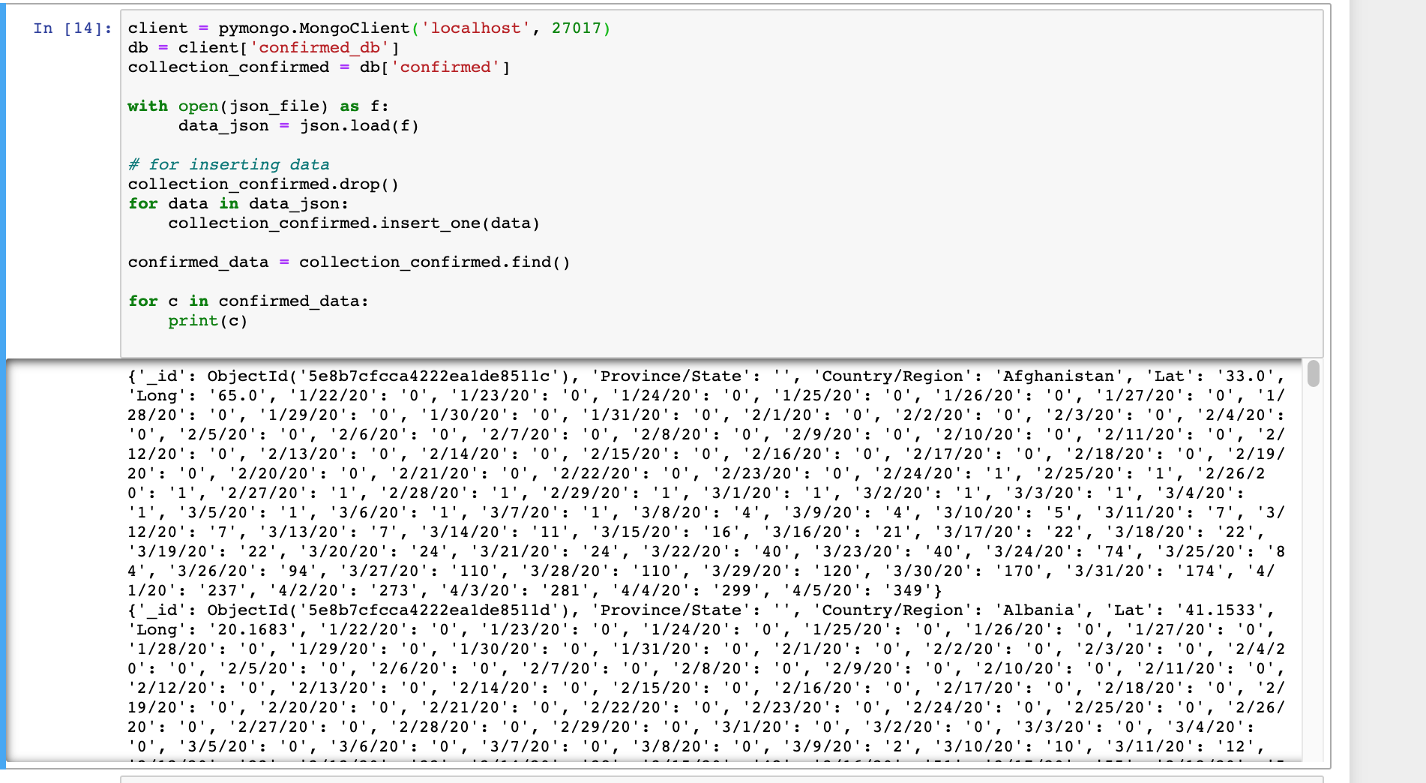
Storing the data in MongoDB and Interacting with database using PyMongo

Slide 10
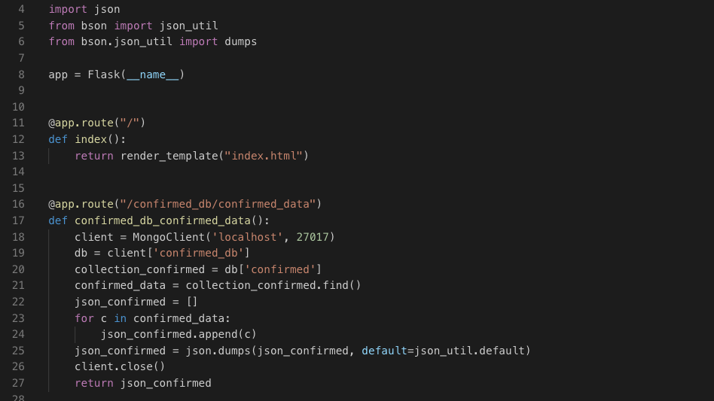
Building the server and Routes
We are using Python Flask for building a server that interact with MongoDB and render the html page that contains our charts. Modifying app.py folder to include the MongoDB query to retrieve all the records from MongoDB along the attributes using separate routes for each database.

Slide 11
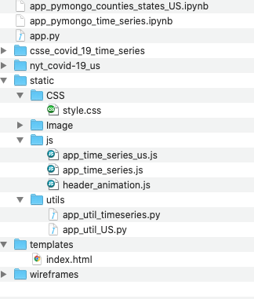
Front-end side preparation
Now that we have the server side code and the MongoDB query ready, we will start building the front end code.
For building the charts, we will be mainly using these list of Javascript libraries d3.js, Leaflet.js, Plotly.js, Google charts, dc Charts ( for filtering the data set) and D3 to do header animation
We will also be using Bootstrap for responsiveness, CSS for styling
Below is the folder structure of our project :

Slide 12
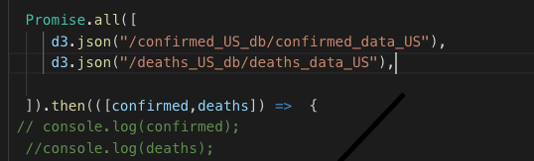
Building the charts
D3.json () promise calls to get the data from the routes to create individual charts :

Slide 13
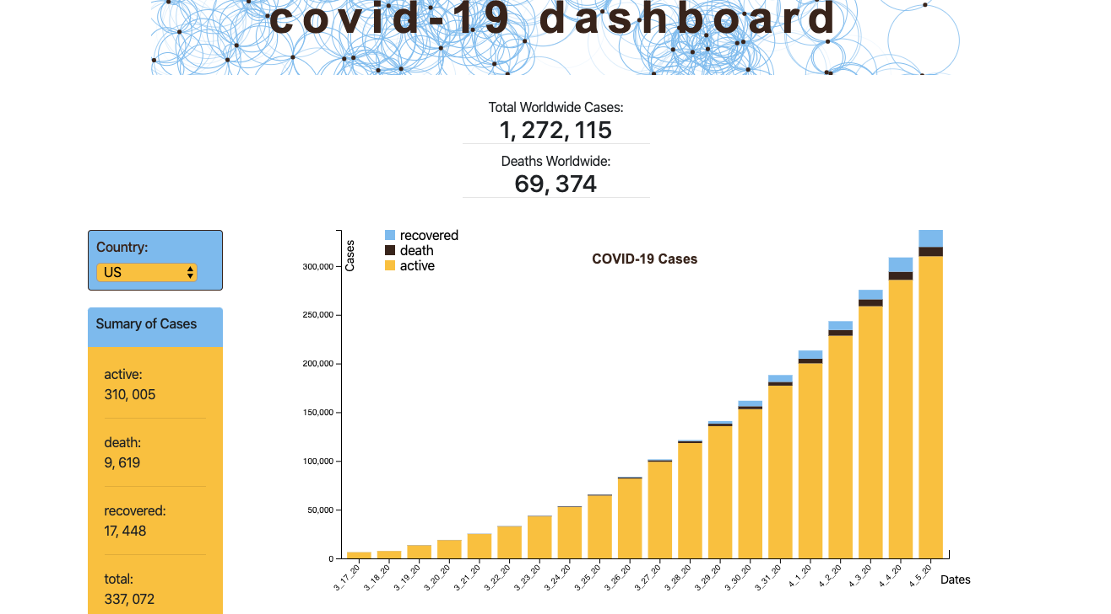
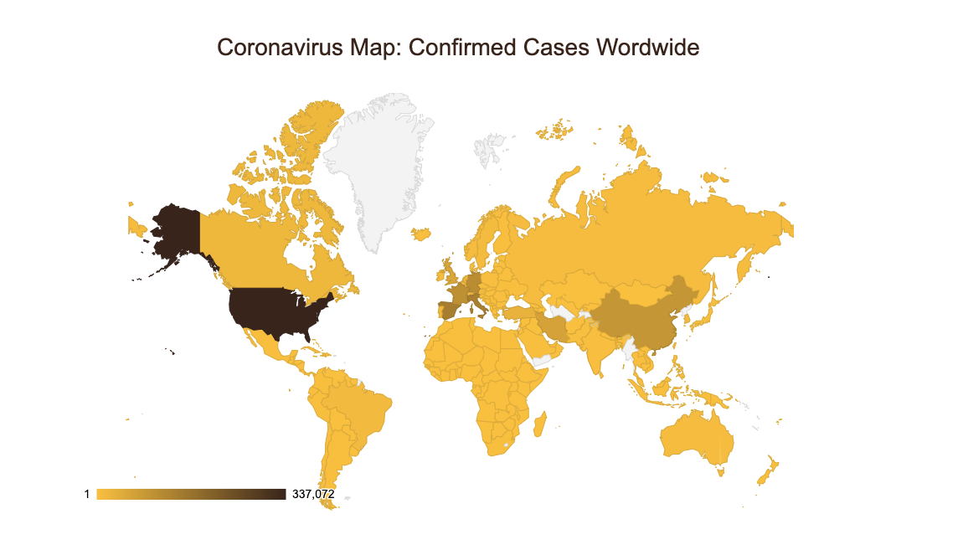
Building the charts ( continued)

Slide 14
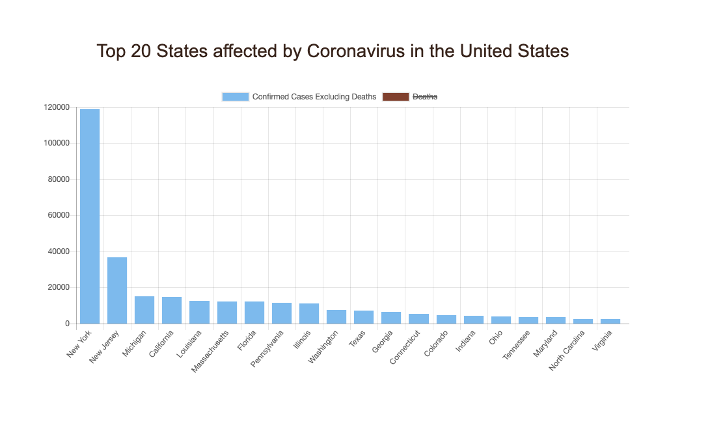
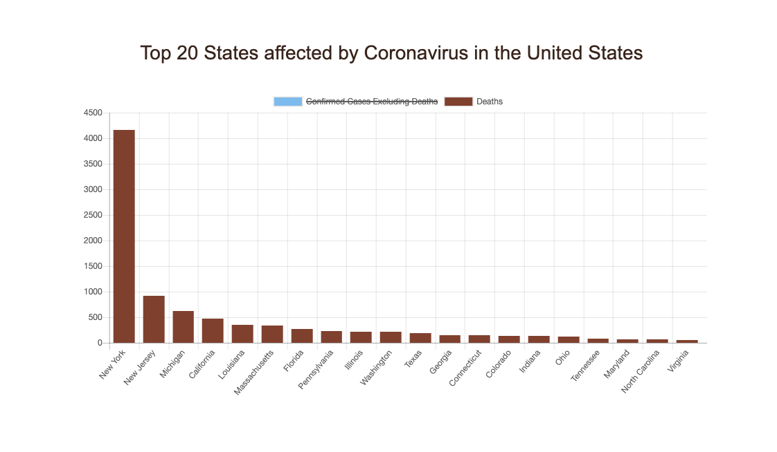
Building the charts with filtering ( continued)

Slide 15
Conclusion

Slide 16


